Slide 1
Powershell Toolmaking and GUI building
Matthias van den Elsacker

Slide 2
PowerShell as programming language
Mostly used as scripting language.
Built on .NET Framework.
C#/VB .NET = Object-Oriented programming languages.
PowerShell has all the building blocks for OO programming:
Objects, classes, functions,…
Conclusion: PowerShell is an OO programming language.

Slide 3
PowerShell Toolmaking
What is “toolmaking”?
More than just scripting.
Building the right “tools” for the job.
Easy to distribute and use.

Slide 4
Example: Password Toolbox
PowerShell Module.
Two functions:
Get-RandomPassword: Generates a random password.
Get-PasswordStrength: Scores a password on length and complexity.
But this only works in the CLI.
And even some system administrators are scared of the CLI…

Slide 5
XAML as presentation layer
Extensible Application Markup Language (XAML).
Based on XML.
Easy to read and share.
No compilation needed.
Used for .NET and Windows Presentation Foundation (WPF).
XAML elements map to classes and functions via .NET API.
So if XAML works with .NET, and Powershell is built on .NET…

Slide 6
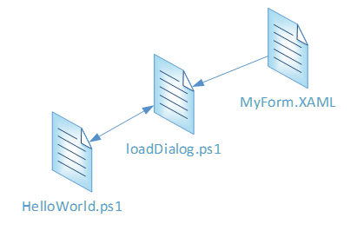
XAML + PowerShell = Interactive GUIs!
“Model-View-Controller”
MyForm.XAML
“View”
Presentation layer.
loadDialog.ps1
“Controller”
Helper/Proxy.
HelloWorld.ps1
“Model”
Actual logic and code to run.

Slide 7
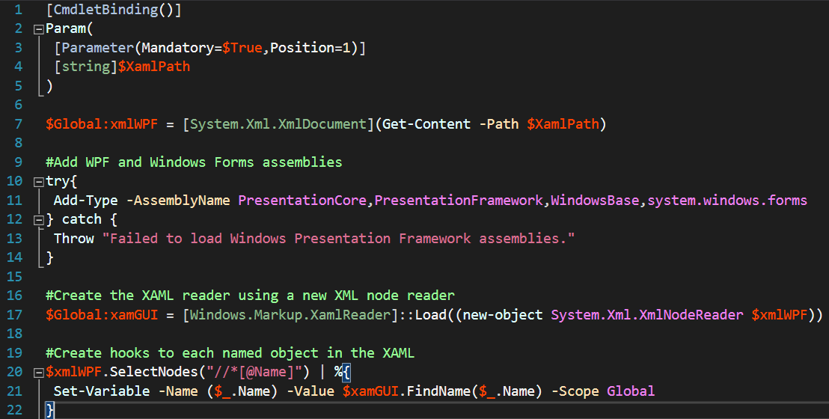
loadDialog.ps1
Read XAML contents.
Load WPF assemblies.
Grab individual elements from XAML.
Create global variables.

Slide 8
How does it work?
Everything with “Name” attribute gets loaded into a global variable.
These variables represent the XAML objects: Label, CheckBox, Slider,…
Add event handlers and access properties via the .NET API.
OnClick, OnValueChanged, IsChecked, Value, Text,…
Put functions containing the logic in the main PS1 script file.

Slide 9
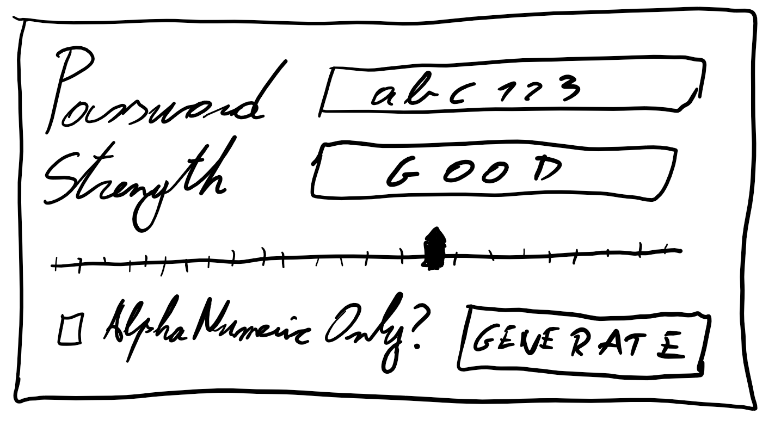
Putting a GUI around our Password Toolbox
Textboxes:
Generated password.
Password strength.
Slider:
To choose the length.
Checkbox:
Alphanumeric only?
Button
Users love pushing buttons.

Slide 10
Live demo: Let’s build a GUI!
DISCLAIMER:
I am not a programmer. Pardon my code.
“Works on my machine”, but should also work on yours.
As long as you have .NET 4.6.1+ and Powershell 5.1+
https://github.com/Matthias-vdE/Haxx
No pull or merge requests.
(Mainly because I don’t really know how GitHub works. CC, anyone?).

Slide 11
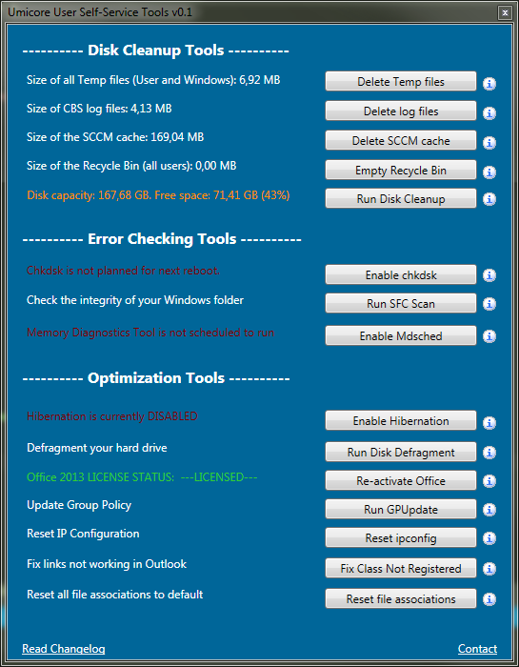
A real-world example: Self-Service Tools
Easy to use.
Actually being used!
Built for users.
Less calls to the helpdesk for small tasks.

Slide 12

But should you though…?
XAML is easy.
You already know PowerShell!
Perfect for System Admins.
Tip: Sapien PowerShell Studio
An IDE specifically designed for building and packaging PowerShell GUIs.
So: Yes, you should.

Slide 13
Q & A

Slide 14
Thank you, and have fun at Haxx!

Slide 15
Resources
https://blogs.technet.microsoft.com/heyscriptingguy/2014/08/01/ive-got-a-powershell-secret-adding-a-gui-to-scripts/
https://foxdeploy.com/2015/04/10/part-i-creating-powershell-guis-in-minutes-using-visual-studio-a-new-hope/
https://docs.microsoft.com/en-us/dotnet/api/system.windows.controls?view=netframework-4.7.2
https://github.com/Matthias-vdE/Haxx

